Slide 1

“Shell and Tube Heat Exchanger and the variation in heat and other factors using Custom Baffles”
A BTech Project Presentation on
By
Siddhant Udgirkar (21910623)
Vishal Reghate (21910702)
Under the Guidance of
Dr. Sandeep Kore
Submitted to
Department of Mechanical Engineering
BRACT’S, Vishwakarma Institute of Information Technology, Pune-48
[AY 2022-23]

Slide 2
Content
Introduction
Literature Review
Problem Definition
Conclusion
References

Slide 3
Introduction
A heat exchanger is a device that is used to transfer heat from one fluid to another, and shell and tube heat exchangers are a common type that are widely used in various industrial and commercial applications. In a shell and tube heat exchanger, one fluid flows through a series of tubes that are surrounded by a second fluid in a shell. The heat is transferred from one fluid to the other through the walls of the tubes.

Slide 4
Custom baffles are used in shell and tube heat exchangers to improve the heat transfer performance and efficiency. They are typically placed inside the shell of the heat exchanger and can have various shapes and configurations. The use of custom baffles can significantly enhance the heat transfer rate and overall heat transfer coefficient, while also reducing the pressure drop. However, the effects of the baffle geometry and spacing on the heat transfer performance are not fully understood, and further research is needed to optimize the design of shell and tube heat exchangers with custom baffles.

Slide 5
Literature Review
A discussion of the factors that affect the performance of shell and tube heat exchangers, such as the heat transfer rate, overall heat transfer coefficient, and pressure drop
A review of the previous research on the use of custom baffles in shell and tube heat exchangers, including the effects of the baffle geometry and spacing on the heat transfer performance
A discussion of the limitations of the previous research and the gaps in knowledge that the current study aims to address
A summary of the key findings and insights from the previous research on shell and tube heat exchangers with custom baffles

Slide 6
Shell and tube heat exchangers are widely used in various industrial and commercial applications to transfer heat from one fluid to another. The performance of shell and tube heat exchangers is influenced by a number of factors, including the heat transfer rate, overall heat transfer coefficient, and pressure drop. Previous research has shown that the use of custom baffles in shell and tube heat exchangers can improve the heat transfer performance and efficiency. However, the effects of the baffle geometry and spacing on the heat transfer performance are not fully understood, and further research is needed to optimize the design of shell and tube heat exchangers with custom baffles.

Slide 7
Need of the project
The need for a project on shell and tube heat exchangers and the variation in heat and other factors using custom baffles may depend on the specific context in which the heat exchanger will be used. Some potential reasons for conducting such a project could include:
To improve the efficiency and performance of an existing shell and tube heat exchanger by optimizing the design and selection of custom baffles.
To design a new shell and tube heat exchanger with custom baffles for a particular application, such as heating or cooling a process fluid in a chemical plant or power generation facility.

Slide 8
To study the effect of different design parameters, such as the size and orientation of the baffles, on the performance of a shell and tube heat exchanger.
To compare the performance of different types of heat exchangers, including shell and tube heat exchangers with and without custom baffles, for a particular application.
To develop new design methods or computational tools for optimizing the use of custom baffles in shell and tube heat exchangers.

Slide 9
Problem Definition
Heat exchangers are widely used in a variety of industrial and commercial applications to transfer heat between fluids. Shell and tube heat exchangers are a common type of heat exchanger, but their performance can be limited by factors such as pressure drop and the heat transfer coefficient. Custom baffles, which are plates or tubes inserted into the shell of the heat exchanger, can be used to improve the performance of shell and tube heat exchangers by enhancing heat transfer and reducing pressure drop. However, the design and selection of custom baffles can be complex, and the optimal design may vary depending on the specific application and design of the heat exchanger.

Slide 10
The goal of this project is to study the effect of custom baffles on the performance of shell and tube heat exchangers and to develop methods for optimizing their design and selection. The project will involve performing experiments and/or computer simulations to investigate the effect of different design parameters, such as the size and orientation of the baffles, on the heat transfer coefficient, pressure drop, and overall performance of the heat exchanger. The results of the study will be used to develop design guidelines and tools for optimizing the use of custom baffles in shell and tube heat exchangers.

Slide 11
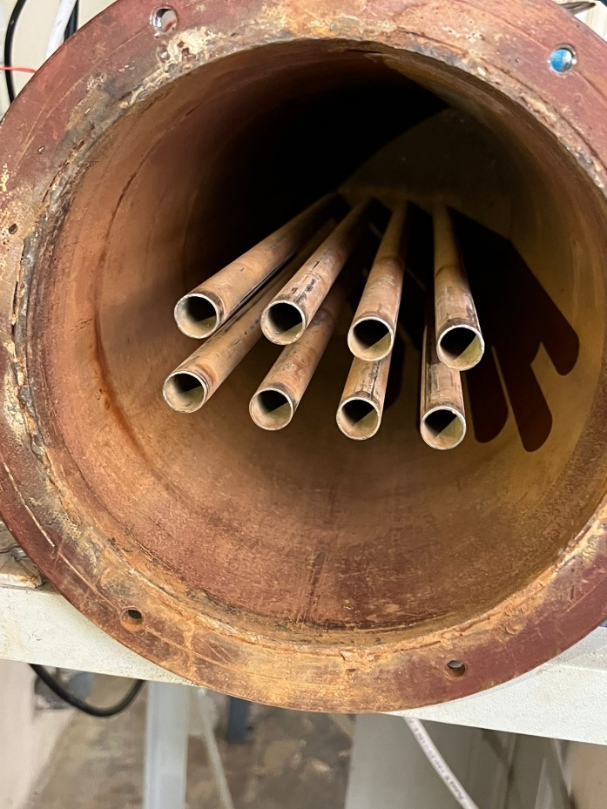
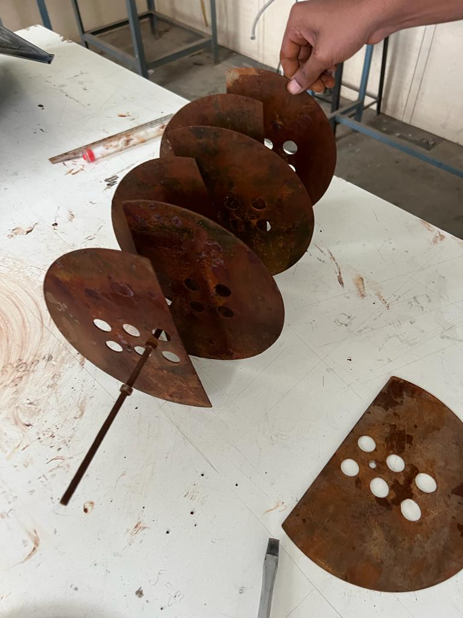
Experiment on segmented baffles on the setup

Slide 12
READINGS OF THE EXPERIMENT
Cross flow and 4 baffles- (Hot Flow 2.5)
Cold flow (LPM) | Hot In (T1) °C | Hot Out (T2) °C | Cold In (T3) °C | Cold Out (T4) °C
2.5 | 47.25 | 42.1 | 31 | 36.2
4.5 | 47.25 | 40.5 | 31 | 33
6.5 | 47.25 | 40 | 31 | 32
8.5 | 47.25 | 39.6 | 31 | 31

Slide 13
Type the slide title
Cross flow and 4 baffles- (Hot Flow 4.5)
Cold flow (LPM) | Hot In (T1) °C | Hot Out (T2) °C | Cold In (T3) °C | Cold Out (T4) °C
2.5 | 37.8 | 33.1 | 31.4 | 32.8
4.5 | 37.8 | 33.1 | 31.4 | 32.9
6.5 | 37.8 | 33.6 | 31.4 | 33.05
8.5 | 37.8 | 33.8 | 31.4 | 33.6

Slide 14
Cross flow and 4 baffles- (Hot Flow 6.5)
Cold flow (LPM) | Hot In (T1) °C | Hot Out (T2) °C | Cold In (T3) °C | Cold Out (T4) °C
2.5 | 35 | 33.3 | 28.9 | 30.8
4.5 | 35 | 33.5 | 28.9 | 30.4
6.5 | 35 | 33.5 | 28.9 | 30.1
8.5 | 35 | 34 | 28.9 | 30.4

Slide 15
Cross flow and 4 baffles- (Hot Flow 8.5)
Cold flow (LPM) | Hot In (T1) °C | Hot Out (T2) °C | Cold In (T3) °C | Cold Out (T4) °C
2.5 | 33.2 | 32.7 | 29.9 | 31.1
4.5 | 33.2 | 32.7 | 29.9 | 30.3
6.5 | 33.2 | 33.2 | 29.9 | 30.3
8.5 | 33.2 | 34.4 | 29.9 | 30.6

Slide 16
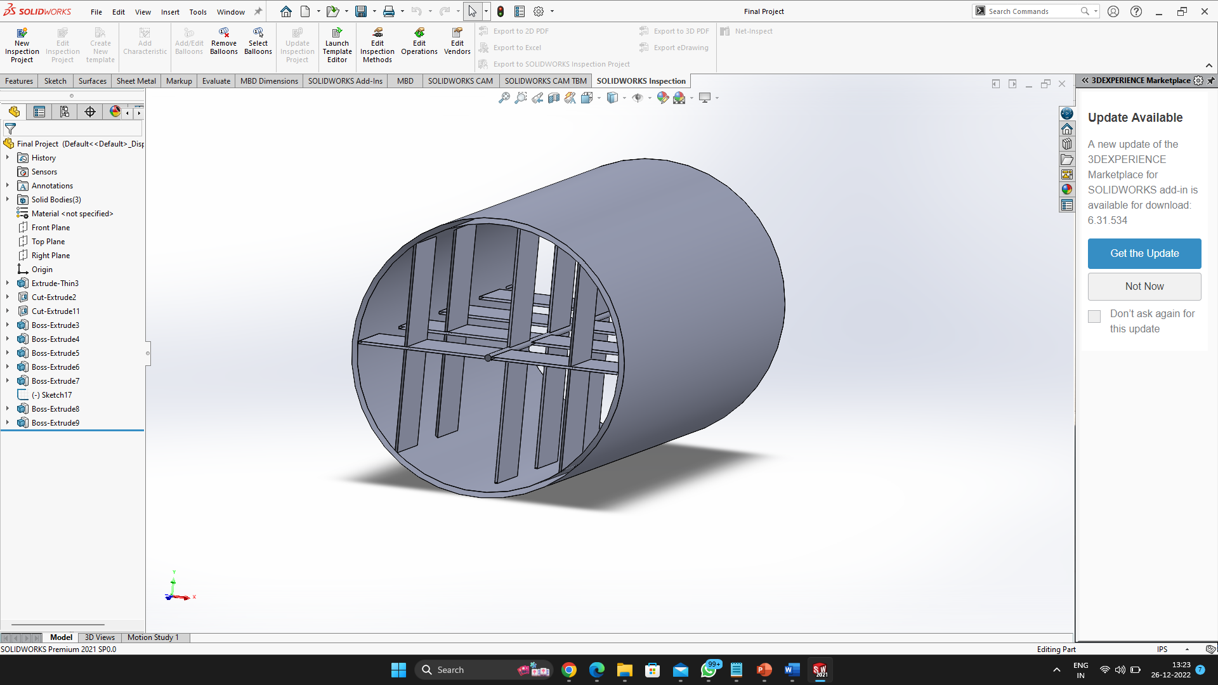
Our Custom Designed Baffles

Slide 17
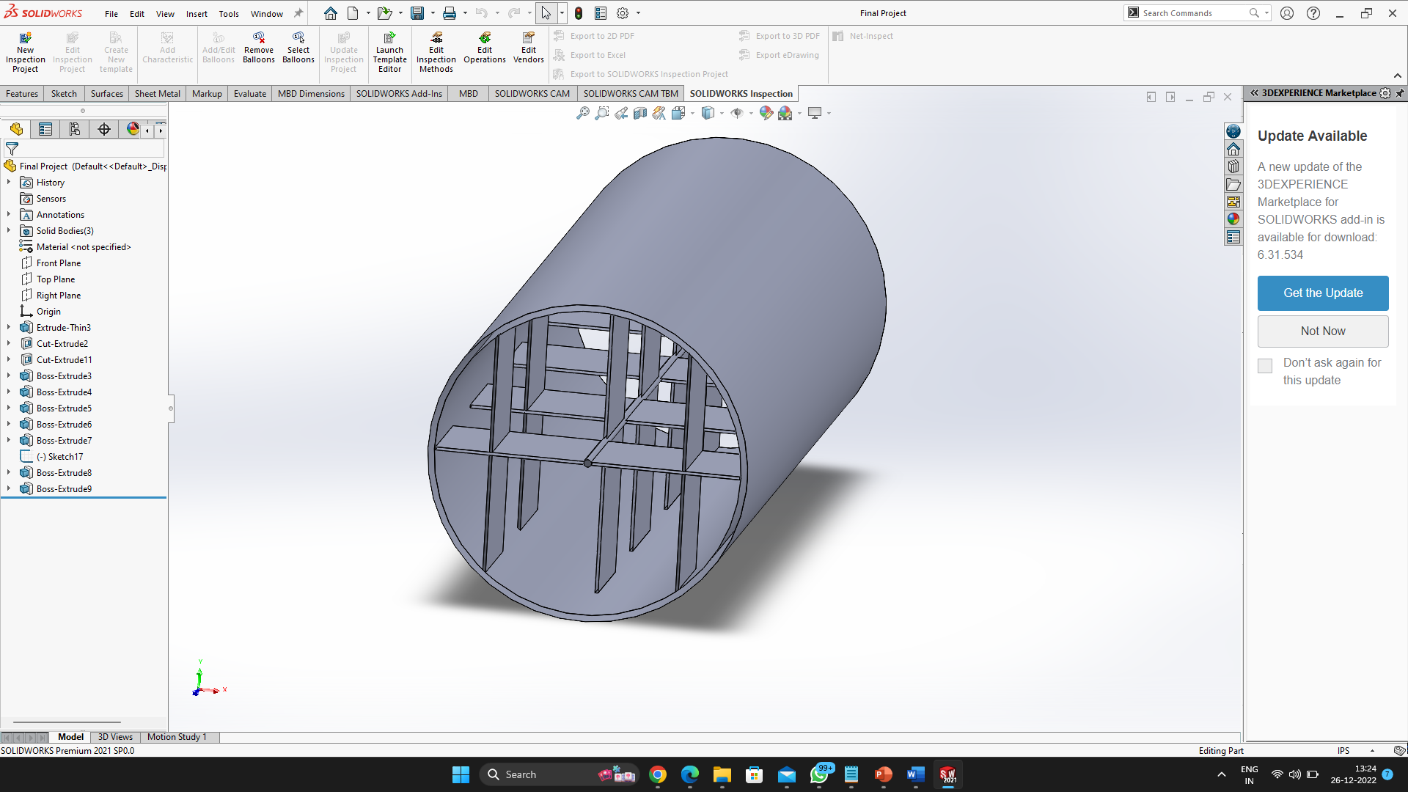

Slide 18
Conclusion
A project on shell and tube heat exchangers and the variation in heat and other factors using custom baffles might involve studying the effect of different design parameters, such as the size and orientation of the baffles, on the heat transfer coefficient, pressure drop, and overall performance of the heat exchanger. The results of the study could be used to develop design guidelines and tools for optimizing the use of custom baffles in shell and tube heat exchangers for different applications.

Slide 19
References
"Heat Exchangers: Selection, Rating, and Thermal Design, Third Edition" by S. K. Ghosh and T. Kuppan
"Heat Exchangers: Fundamentals and Applications" by T. L. Bergman, A. S. Lavine, F. P. Incropera, and D. P. DeWitt
"Heat Exchangers: Selection, Rating, and Thermal Design" by S. K. Ghosh
"Heat Exchangers: Types and Applications" by R. K. Shah and D. R. Sekulib
"Heat Exchangers: Selection, Rating, and Thermal Design" by S.K. Shah and D.R. Lewin, provides a comprehensive overview of heat exchanger design, including shell and tube heat exchangers and the use of custom baffles.

Slide 20
"Handbook of Heat Exchanger Design" by H.Y. Sohn and W.M. Kays, is a comprehensive reference on heat exchanger design, including shell and tube heat exchangers with custom baffles.
"Heat Transfer Equipment Design" by J.H. Harker and J.R. Edwards, is a textbook that covers the design and analysis of heat transfer equipment, including shell and tube heat exchangers with custom baffles.
"Heat Exchanger Design Handbook, Second Edition" by T. Kuppan. This handbook provides detailed information on the design, selection, and operation of shell and tube heat exchangers, including the use of custom baffles to optimize performance.

Slide 21

Thank you
Questions

